Slide 1
Quiz 1
Group C
Mia Diliberti-Brandenburg, John Pollak, Kelly Williams

Slide 2
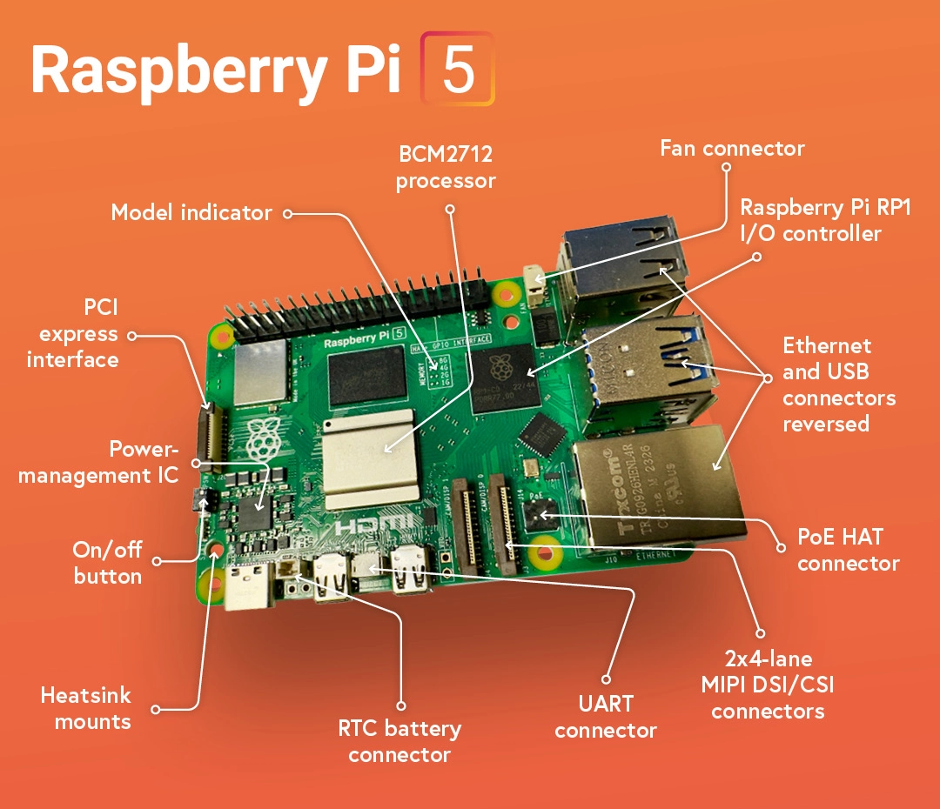
ARM Cortex-A76 Architecture
Harvard ARMv8-A
Allows for cryptography extensions (optional)
64-bit
Quad core
Broadcom BCM2712 SoC (System on Chip)
Handles CPU, GPU, SDRAM, HDMI, PCIe, other fast interfaces
2.4GHz clock speed
512KB per-core L2 caches
2MB L3 cache
12-core VideoCore VII GPU
32-but LPDDR4X memory interface
Advertises 2-3x more performance than rpi-4
Vector execute unit can run cryptographic instructions

Slide 3
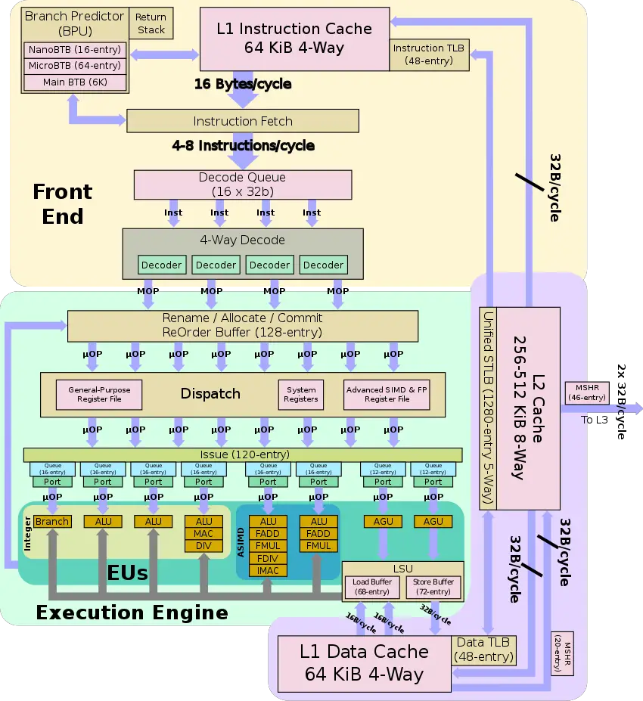
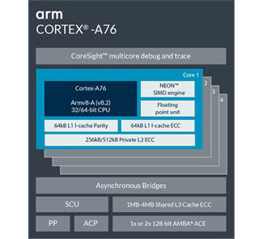
Block Diagram

Slide 4
Cryptography Extensions - What are they?
Instruction Set Architectures often add new instructions to optimize certain repeating processes (vector processes, floating point operations, etc.)
With the prevalence of running cryptographic algorithms, some manufacturers have added extensions for their ISA which specifically address those algorithms.
This includes not just ARM, but Intel as well (starting in 2010.)
Crypto extensions reduce computational and code complexity.
For example, AES requires several rounds of assembler instructions which correspond to each round in the algorithm.
In ARM, these extensions are optional and can be switched on and off with assembly directives.
Notes:
Extensions also can add functionality for new coprocessors and additional registers, such as widening the memory space. Software implementations often use lookup tables to implement algorithms like AES; with increasing complexity, this causes significant slowdowns, particularly in embedded systems.

Slide 5
Cryptography Extensions Interfacing with Pi-5
Cryptography extensions can interface with the Pi-5 two different ways:
User-space libraries like applications that link the calls within the processor
Linux Kernel Crypto API which uses the kernel framework that implements crypto for in-kernel users.
These two methods do contain a user application interface for controlling the crypto extension.
The path for the library would be OpenSSl→AArch64 →Armv8 and the kernel would be AF_ALG socket→Linux Kernel Crypto API→aes cipher→Armv8
Both of theses paths utilize the Armv8 Crypto Extensions on the COrtex-A76 for AES/SHA acceleration.

Slide 6
Rust on the Pi-5
C++ was traditionally used on the Pi-5, but Rust was developed to overcome obstacles with using C++. Rust, like C++:
Has better performance than higher level languages
Has better memory usage
Doesn’t require a garbage collector, so resources are saved
However, Rust is preferred over C++ and is seen as better than C++ because:
Uses Cargo, which on top of being used as a way to write code, is a smarter way to recompile code because of its ability to only track changes and note those changes rather than having to recompile the entire code again
Has a more modern ecosystem
Has better memory management
Rust can be used on the Pi-5 using Linux and compiled using the Pi-5’s ARM CPU.

Slide 7
Links/References
ARMv8 Crypto Extensions
ARM Cortex-A76 info
ARMv8-A Architecture
Ç. K. Koç , Ed., Cryptographic Engineering. New York, NY, United States: Springer, 2009, pp. 191–196, 203–204.
Intel Advanced Encryption Standard Instructions (AES-NI)
ARM Options (GNU Binutils)
“7 Reasons Why You Should Use Rust Programming for Your next Project.” Simple Programmer, 18 Dec. 2020, simpleprogrammer.com/rust-programming-benefits/.

Slide 8
Thank you!
Group C
Mia Diliberti-Brandenburg, John Pollak, Kelly Williams

Slide 9
Task
As the Quiz #1 will be in October 1st,2025. I am expecting for each team to deliver the following:
1) A set of slides describing how the crypto-engine on the PI-5 is working
2) Benchmark the set of functions within the engine with showing how it works and co-operating with the OS on the main processor on the PI
3) A small demo on using the engine versus implementation using ISA instructions (The normal c/rust code running on the actual processor --> You can run AES as example on both the engine and the main processor)
4) you have to create a subfolder and the repo with the name of your group and load this information.

Slide 10
